Slide 1
Simple Linear Regression Model

Slide 2
Linear regression is a very simple method but has proven to be very useful for a large number of situations. In this chapter you will discover exactly how linear regression works step-by-step. After reading this chapter you will know:
 How to calculate a simple linear regression step-by-step.
 How to make predictions on new data using your model.
 A shortcut that greatly simpliﬁes the calculation.

Slide 3
Tutorial Data Set
The data set we are using is completely made up. Below is the raw data.
X | Y
1 | 1
2 | 3
4 | 3
3 | 2
5 | 5

Slide 4
The attribute x is the input variable and y is the output variable that we are trying to predict. If we got more data, we would only have x values and we would be interested in predicting y values. Below is a simple scatter plot of x versus y. We can see the relationship between x and y looks kind-of linear. As in, we could probably draw a line somewhere diagonally from the bottom left of the plot to the top right to generally describe the relationship between the data. This is a good indication that using linear regression might be appropriate for this little dataset.

Slide 5
Simple Linear Regression
When we have a single input attribute (x) and we want to use linear regression, this is called simple linear regression. If we had multiple input attributes (e.g. X1, X2, X3, etc.)
The procedure for linear regression is diﬀerent and simpler than that for multiple linear regression, so it is a good place to start. In this section we are going to create a simple linear regression model from our training data, then make predictions for our training data to get an idea of how well the model learned the relationship in the data. With simple linear regression we want to model our data as follows:

Slide 6
y = B0 + B1×x
y = B0 + B1×x This is a line where y is the output variable we want to predict, x is the input variable we know and B0 and B1 are coeﬃcients that we need to estimate that move the line around. Technically, B0 is called the intercept because it determines where the line intercepts the y-axis. In machine learning we can call this the bias, because it is added to oﬀset all predictions that we make. The B1 term is called the slope because it deﬁnes the slope of the line or how x translates into a y value before we add our bias.

Slide 7
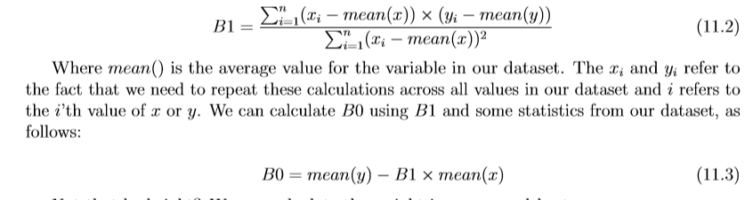
The goal is to ﬁnd the best estimates for the coeﬃcients to minimize the errors in predicting y from x. Simple regression is great, because rather than having to search for values by trial and error or calculate them analytically using more advanced linear algebra, we can estimate them directly from our data. We can start oﬀ by estimating the value for B1 as:

Slide 8
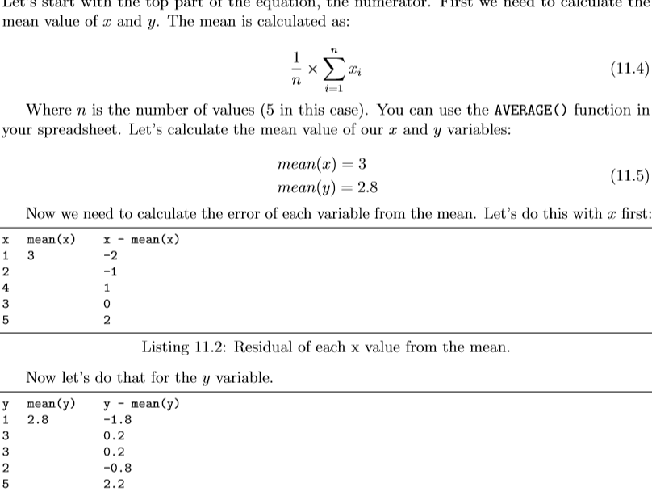
Estimating The Slope (B1)

Slide 9
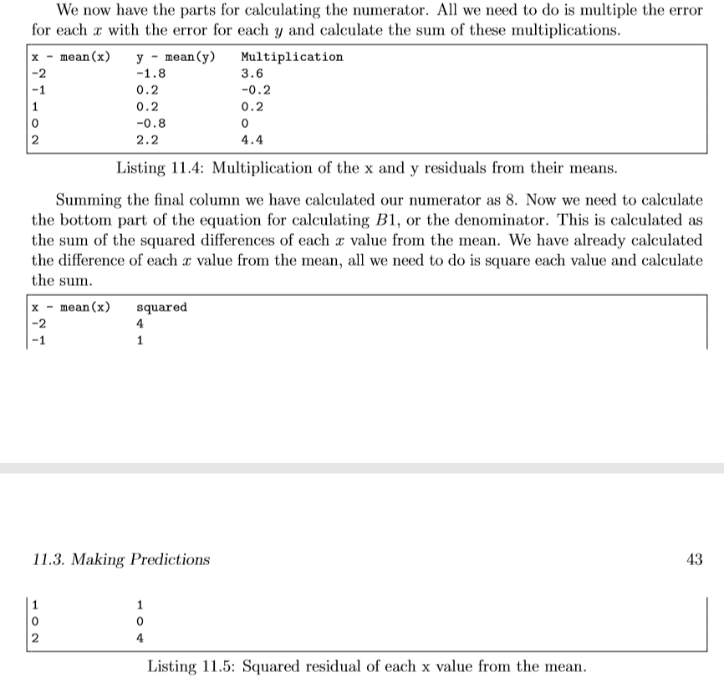

Slide 10
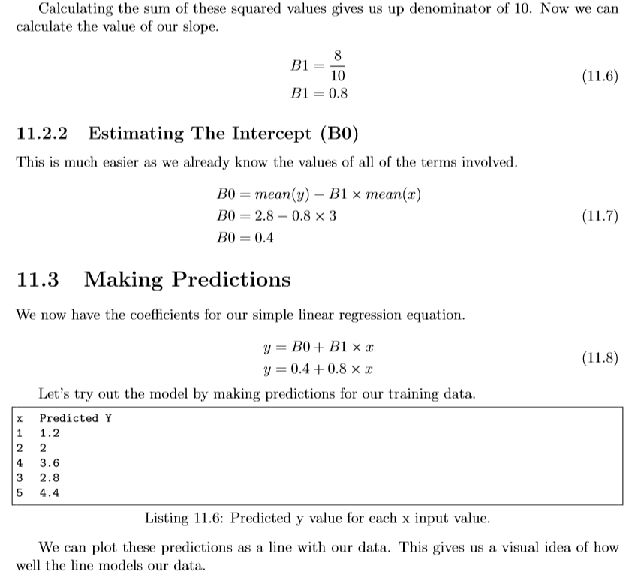

Slide 11
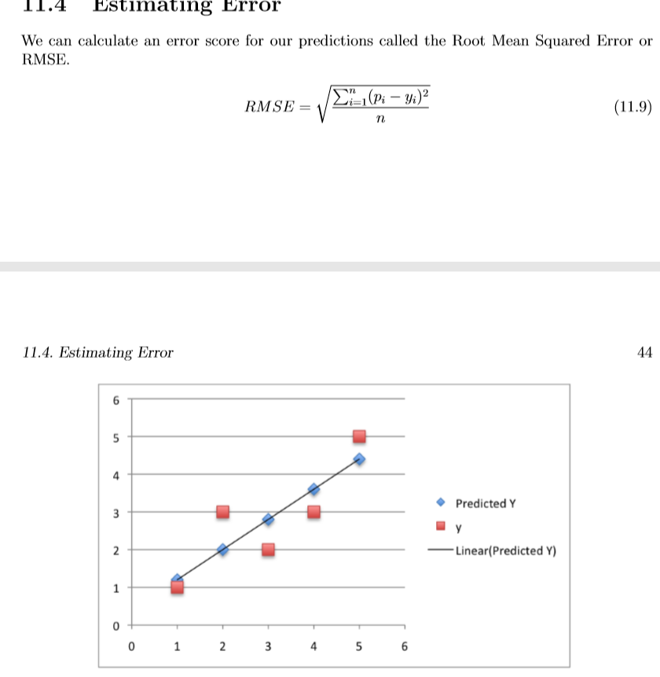

Slide 12
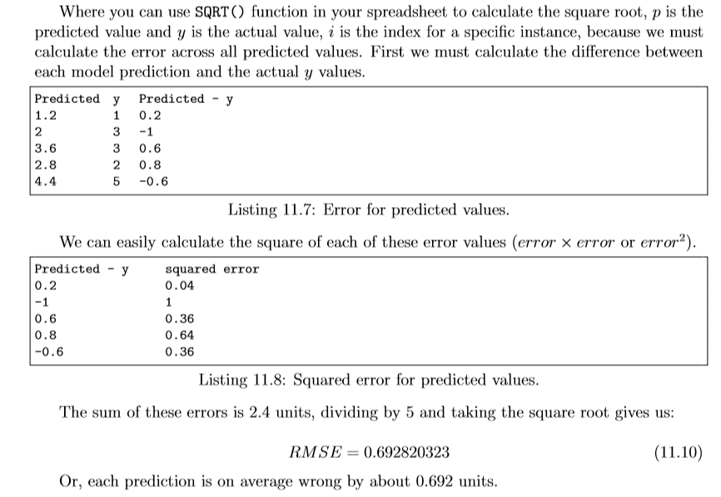

Slide 13
import numpy as np
import matplotlib.pyplot as plt
def estimate_coef(x, y):
# number of observations/points
n = np.size(x)
# mean of x and y vector
m_x, m_y = np.mean(x), np.mean(y)
# calculating cross-deviation and deviation about x
SS_xy = np.sum(y*x) - n*m_y*m_x
SS_xx = np.sum(x*x) - n*m_x*m_x
# calculating regression coefficients
b_1 = SS_xy / SS_xx
b_0 = m_y - b_1*m_x
return(b_0, b_1)

Slide 14
def plot_regression_line(x, y, b):
# plotting the actual points as scatter plot
plt.scatter(x, y, color = "m",
marker = "o", s = 30)
# predicted response vector
y_pred = b[0] + b[1]*x
# plotting the regression line
plt.plot(x, y_pred, color = "g")
# putting labels
plt.xlabel('x')
plt.ylabel('y')
# function to show plot
plt.show()

Slide 15
def main():
# observations
x = np.array([0, 1, 2, 3, 4, 5, 6, 7, 8, 9])
y = np.array([1, 3, 2, 5, 7, 8, 8, 9, 10, 12])
# estimating coefficients
b = estimate_coef(x, y)
print("Estimated coefficients:\nb_0 = {} \
\nb_1 = {}".format(b[0], b[1]))
# plotting regression line
plot_regression_line(x, y, b)
if __name__ == "__main__":
main()

Slide 16
Output of above piece of code is:
Estimated coefficients:
b_0 = -0.0586206896552
b_1 = 1.45747126437

Slide 17
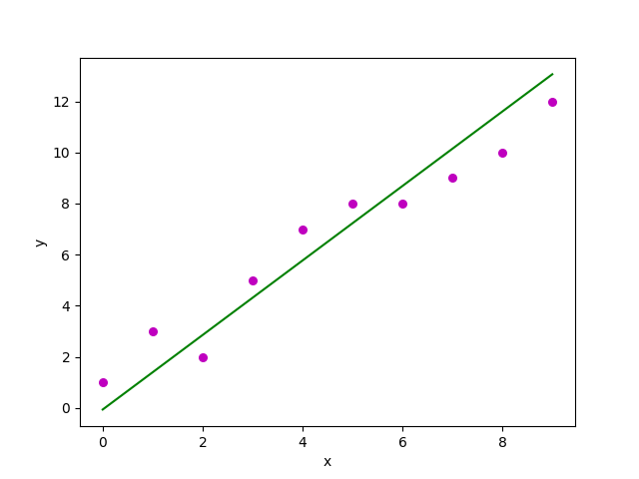
And graph obtained looks like this:

